Slide 1
Parsers
Why Remove Left Recursion?
Yonatan Ayisheshim, BDU1508377, Instructor Name: Lec. Wendimu

Slide 2
Objectives & Overview
Understanding Left Recursion in LL Parsers

Slide 3
Context of Syntax Analysis
Understanding the Parsing Process
Role of the Syntax Analyzer
The syntax analyzer is crucial as it converts tokens generated during lexical analysis into structured parse trees. LL parsing operates from the top-down, validating syntax using Context-Free Grammars (CFGs).

Slide 4
What is Left Recursion?
Understanding direct and indirect forms
Direct Left Recursion
Indirect Left Recursion
Direct left recursion occurs when a non-terminal directly references itself in its production, leading to immediate repetition without consuming any input, causing infinite loops during parsing.
Indirect left recursion arises when a non-terminal refers to another non-terminal that eventually leads back to itself, creating a cycle that complicates parsing and can also cause infinite recursion.

Slide 5
The Core Conflict
Understanding LL Parser Limitations
Non-Terminal Expansion
Infinite Recursion
Predictive Failure
An LL parser attempts to expand a non-terminal before consuming any input tokens, leading to potential issues when faced with recursive rules in the grammar structure.
Left recursion introduces infinite recursion, as the parser recursively calls the non-terminal without consuming any input, resulting in a loop that never terminates or progresses.
Due to infinite recursion, the parser's lookahead token remains unchanged, preventing it from making any predictive decisions on how to proceed with the parsing process.

Slide 6
Non-Determinism in LL(1) Parsing
Left Recursion
Ambiguous Entries
Parsing Failure
Left recursion in grammar leads to ambiguous multiple entries in LL(1) parsing tables.
Multiple entries in the same cell create non-determinism for the parser's selection process.
The inability to deterministically choose productions results in syntax analysis failures.

Slide 7
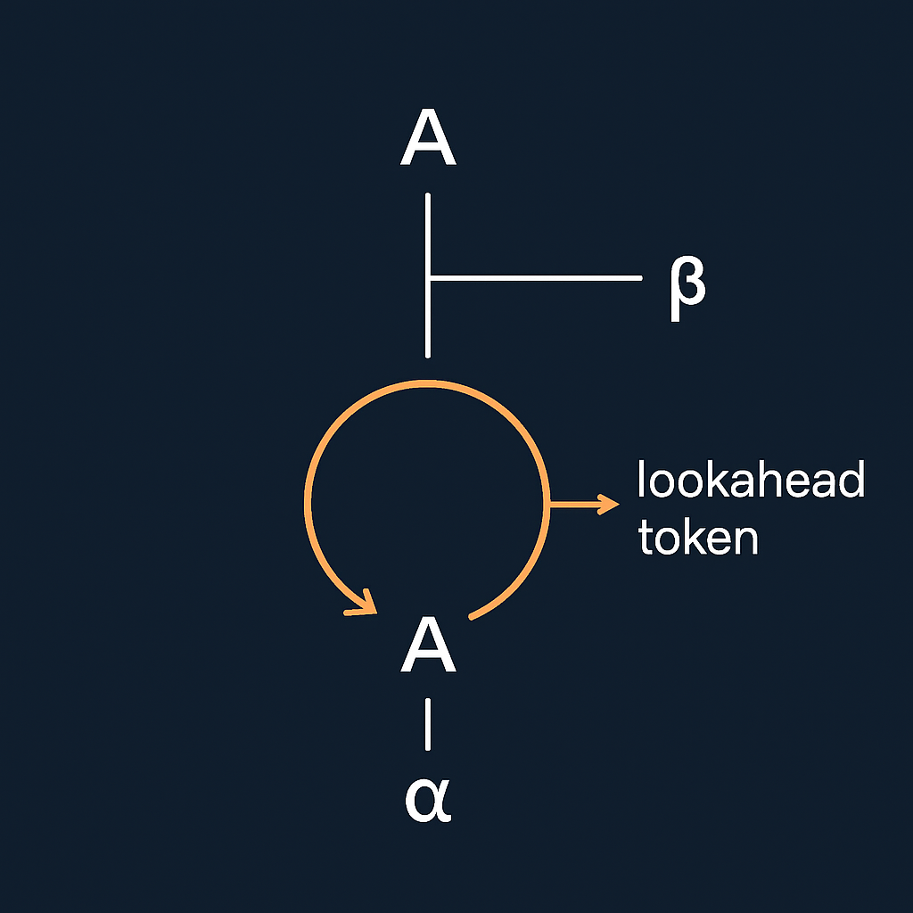
Visualizing Left Recursion
In a left-recursive grammar, the parse tree continually expands leftward, creating an infinite loop. The lookahead token remains unchanged, halting progress as the parser repeatedly attempts to expand the leftmost non-terminal without consuming any input tokens.

Slide 8
The Solution
A → β A′
A′ → α A′
A′ → ε
Eliminating Direct Left Recursion
Transformation Rule
Correctness Preservation
To eliminate left recursion, we transform the grammar from A → Aα | β to A → β A′, ensuring the base case is matched first, then handles repetitions.
This transformation preserves the language's correctness, allowing the parser to operate predictively, thus avoiding infinite loops and ensuring reliable syntax analysis in LL parsers.

Slide 9
Unsafe example:
function parse(input) {
return parse(input); // never stops
}
Safe example:
function parse(input) {
if (!input) return null;
return handle(input);
}
Code Snippet Example
Demonstrating Unsafe and Safe Implementation
Unsafe Implementation
Safe Implementation
Transition Explanation
The unsafe implementation of the recursive descent parser begins with a function that recursively calls itself before consuming any input, leading to potential infinite loops and stack overflow issues.
In the safe implementation, the function first checks for the base case, ensuring that input is consumed appropriately before any recursive calls, effectively preventing infinite recursion and enhancing reliability.
This transition from unsafe to safe coding practices illustrates the necessity of removing left recursion in parsers, highlighting how proper design principles improve parser performance and correctness.

Slide 10
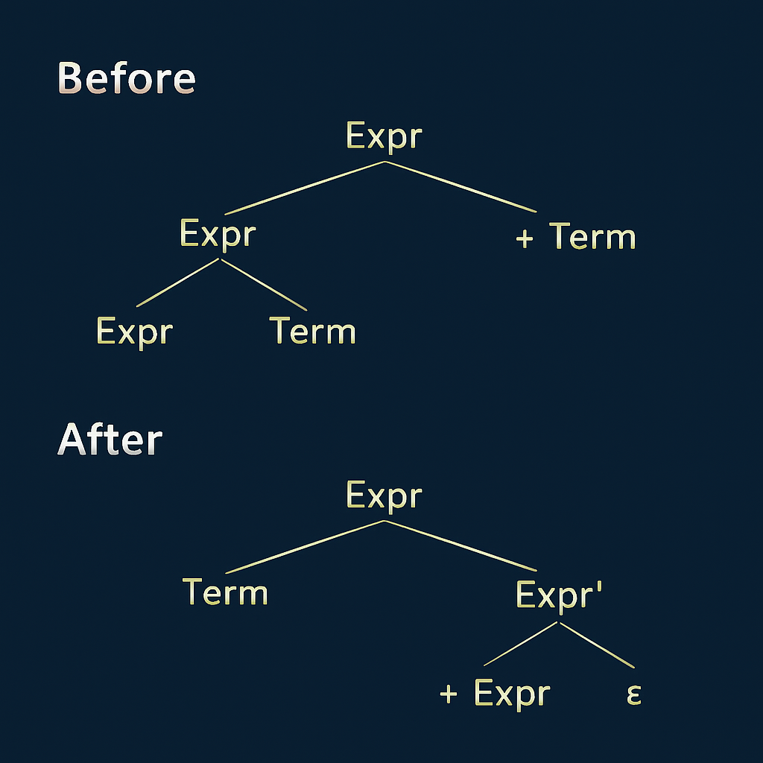
Grammar Transformations
Indirect Left Recursion
Understanding indirect left recursion is critical for effective syntax analysis. We illustrate grammar transformations with clear parse trees demonstrating the process before and after left recursion removal.

Slide 11

Real-World Tools
Compiler Examples
YACC and Bison, though primarily bottom-up parsers, handle left recursion differently. ANTLR requires left recursion removal for effective LL parsing and grammar processing in compilers.

Slide 12
Conclusion
Removing left recursion is essential for LL parsers to function correctly. It prevents infinite loops and allows parsers to build deterministic parsing tables using a single look ahead token.

Slide 13
References
  Aho et al., Compilers
  Grune & Jacobs, Parsing Techniques
  Cooper & Torczon, Engineering a Compiler

